Slide 1


“Diseases Decision Making According to Symptoms” (DD-MAS)
Manish Toshwal Submitted To
2K20/CO/256 Dr. Rohit Beniwal
Computer Science

Slide 2

Objective/problem statement
The main objective of our project is to make a system that could analyze the disease on the basis of the symptoms selected by the user. We call it "Disease Decision Making According to Symptoms"(DD-MAS). Our system gives, user a brief idea of his/her health condition. It has a well-defined database for analysis of 41 unique predefined diseases with their symptoms, its brief description and 4 precautions. Our project has a user friendly, easy to use graphical and interactive user interface.

Slide 3
Motivation
As we all know after corona pandemic our lives have changed, more in the negative way though. We all remember the initial months of pandemic hitting India, there was an immense load on an already stressed medical infrastructure of a developing country. Suddenly all medical facilities and staff got concentrated towards covid, as it was need of the moment too, but all other diseases got carried away in those covid times. General OPD got closed, and people got ignorant to other diseases which could be even more harmful to them than covid. There are times when we develop some symptoms but either we are too much ignorant to them or due to our busy schedule we often avoid visit to a clinic. We tried to provide something handy, an on the go diagnostic tool. Keeping in mind the above situations, we developed our "DD-MAS" (Disease Decision Making According to Symptoms) windows application which would help the user to get an quick analysis of his/her health condition that could be a sign of a serious disease. Which include limited precautions, possible disease and it's description. This tool could be very useful to give a quick and estimated analysis of your condition.

Slide 4
Introduction
"DD-MAS"(Disease Decision Making According to Symptoms) is a window/computer application which works on the basis of symptoms selected by the user while all the symptoms are arranged in alphabetical order for convenience of the user, it has a list of 41 predefined diseases in its database, with its brief description and 4 precautions regarding each disease.
DD-MAS takes 3 symptoms as an input and on their basis, it shows the possible disease to the user. All the disease and symptoms are managed such that there is a unique set of 3 symptoms regarding each disease (while 1-2 symptoms could be common among diseases).
There is a login page in the app which have few predefined username and password in the code itself, like "DTU" and "DTU", and another is "default" and "default".
Note: All the 41 diseases and their symptoms are well researched and are taken from reliable sources.

Slide 5

Background
Our primary focus is on developing a handy, accessible to all diagnosis system/tool, which could give a quick and reliable review of our health conditions to increase awareness among people, because most of
us take our health issues for granted which could have an adverse effect on us in future.

Slide 6
Approach/Implementation
We first took up a tool to develop an interactive graphical user interface (GUI) our search ended with selecting "Qt" as our GUI and C++ as our primary programming language (we selected C++ as we are familiar to it). First, we created a graphical login page for our app, all the graphical work was done using "CSS" in stylesheet on Qt.
Then we collected disease and their symptoms in excel sheet, and converted it into "SQLite" database for easy access by our program. Database is formed such that each disease has a unique set of 3 symptoms, while there are 24 different combination of 4 symptoms for each disease and user can select any 3 of them from drop down list.
Database also includes 4 precautions and a brief description each disease. All the data from the database is fetched using "SQL queries".

Slide 7
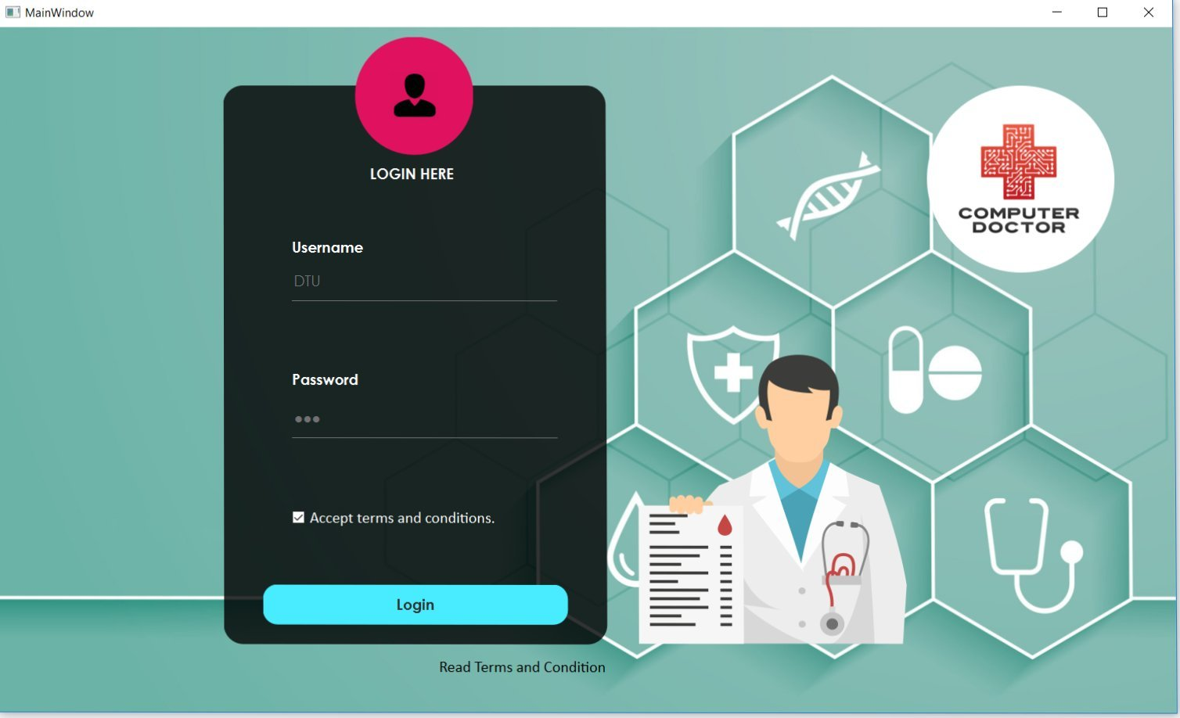
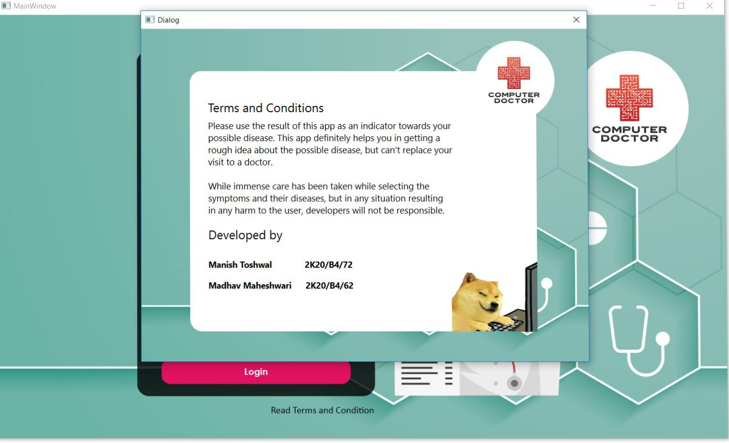
Results/screenshots
Login Page -
Terms and Conditions -

Slide 8
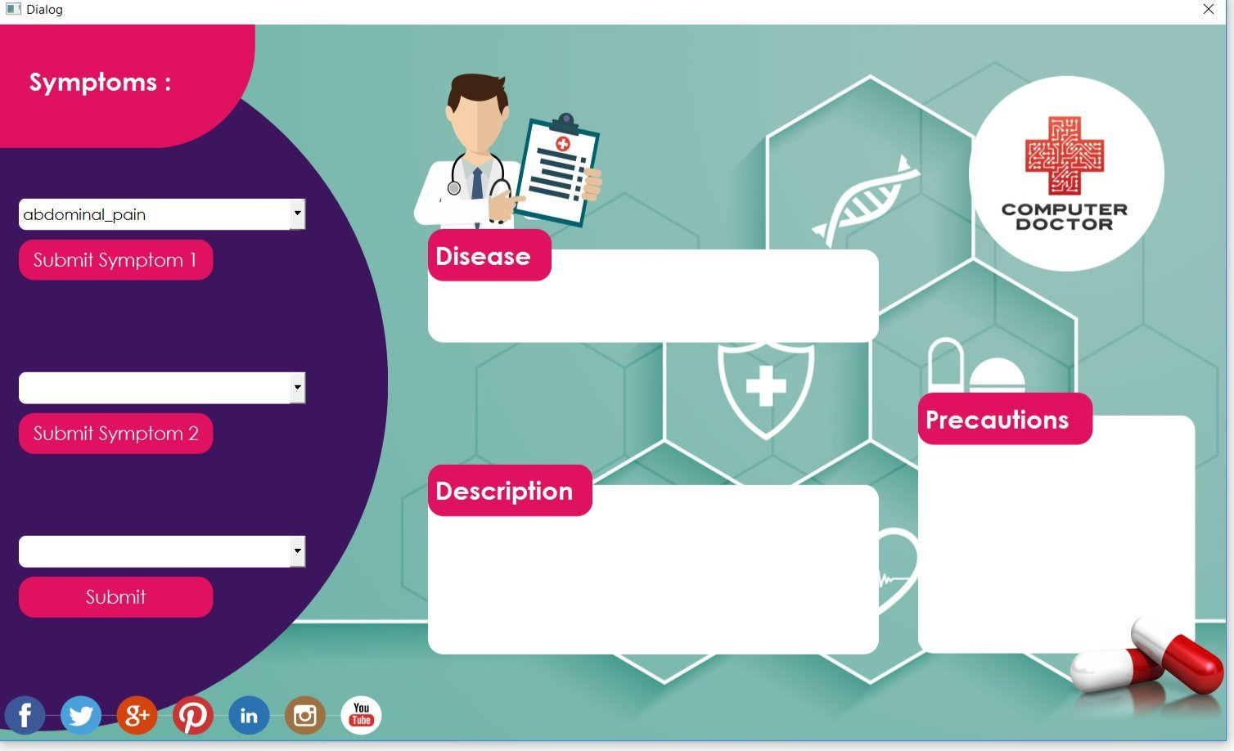
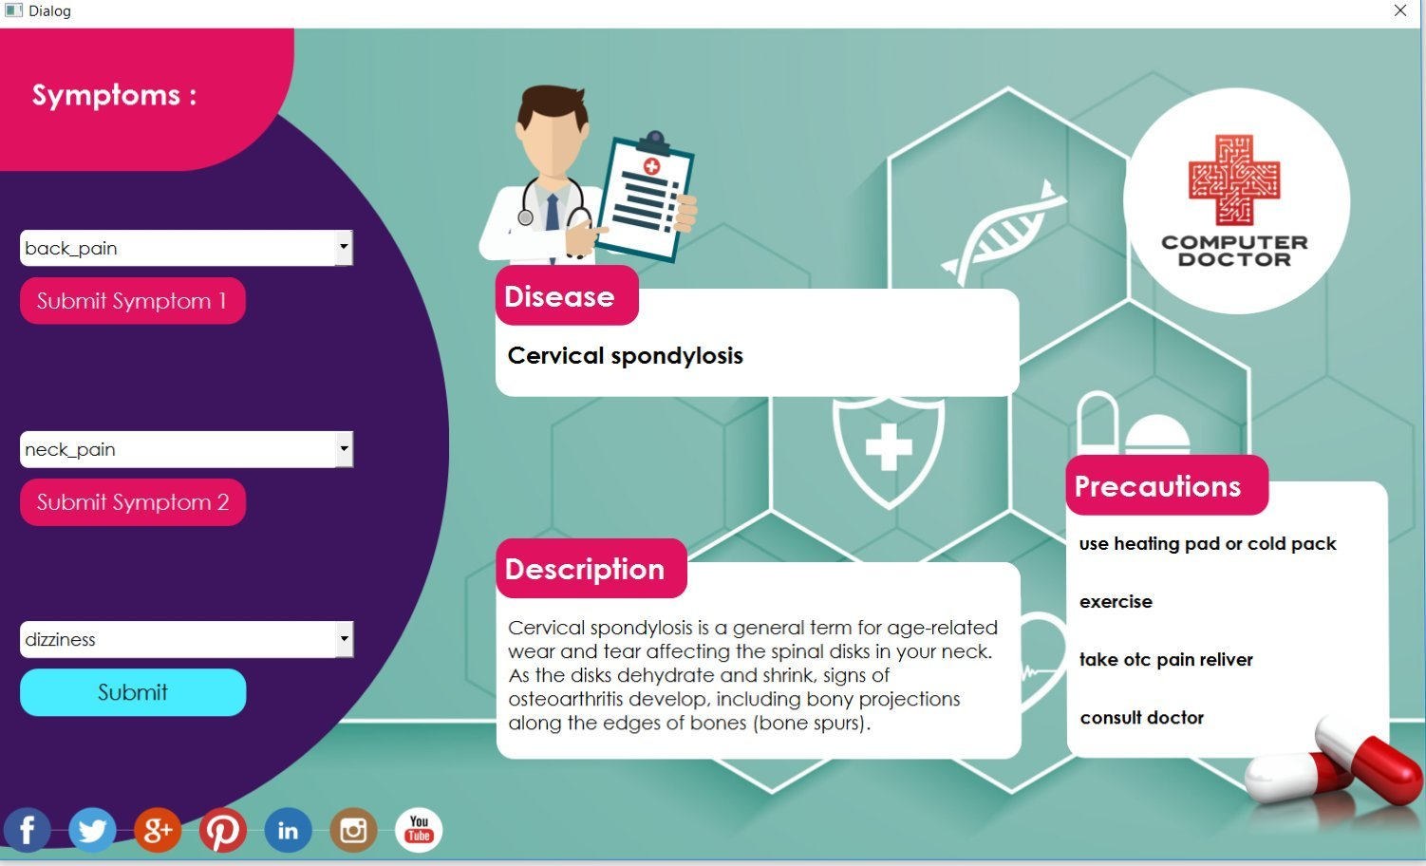
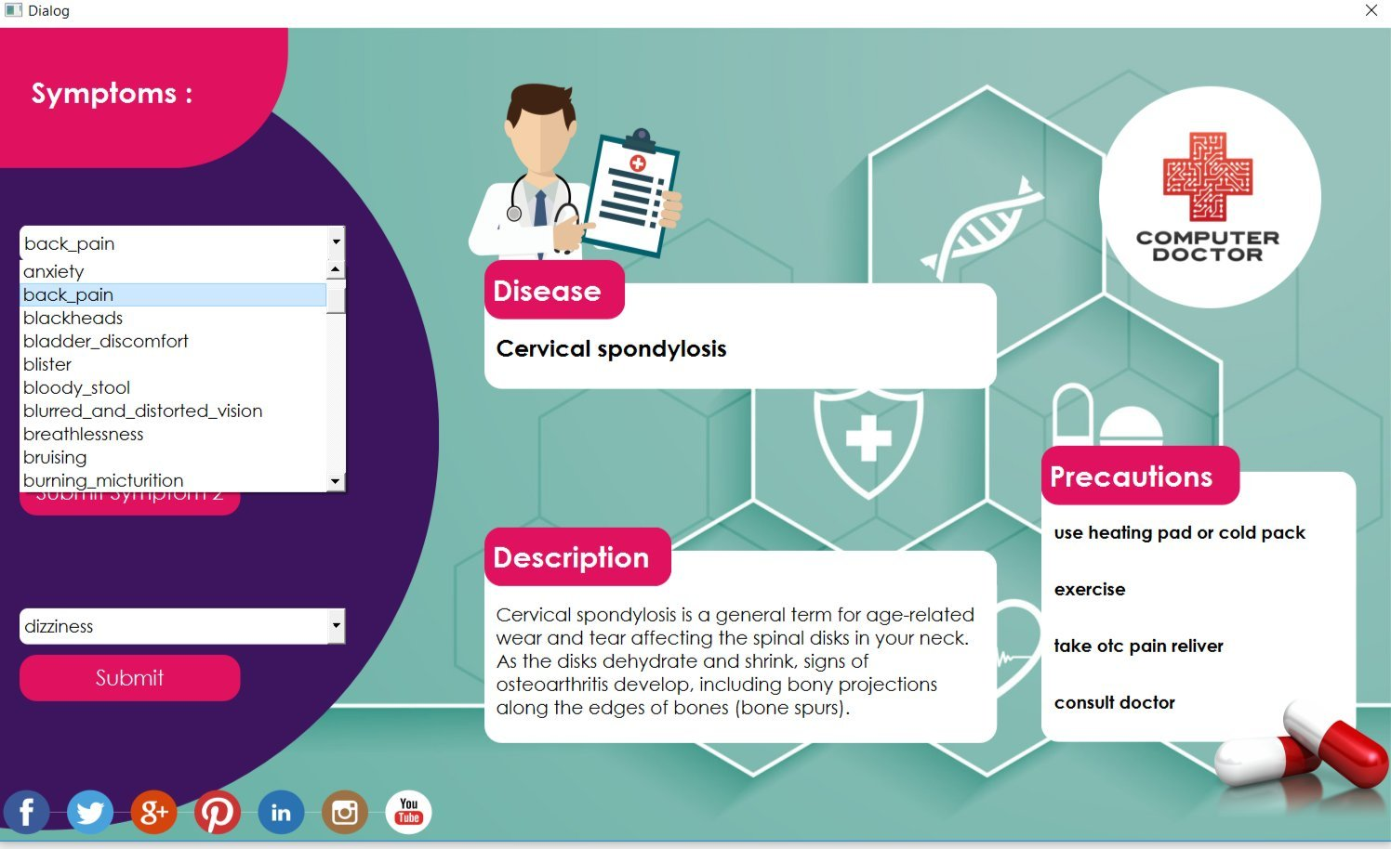
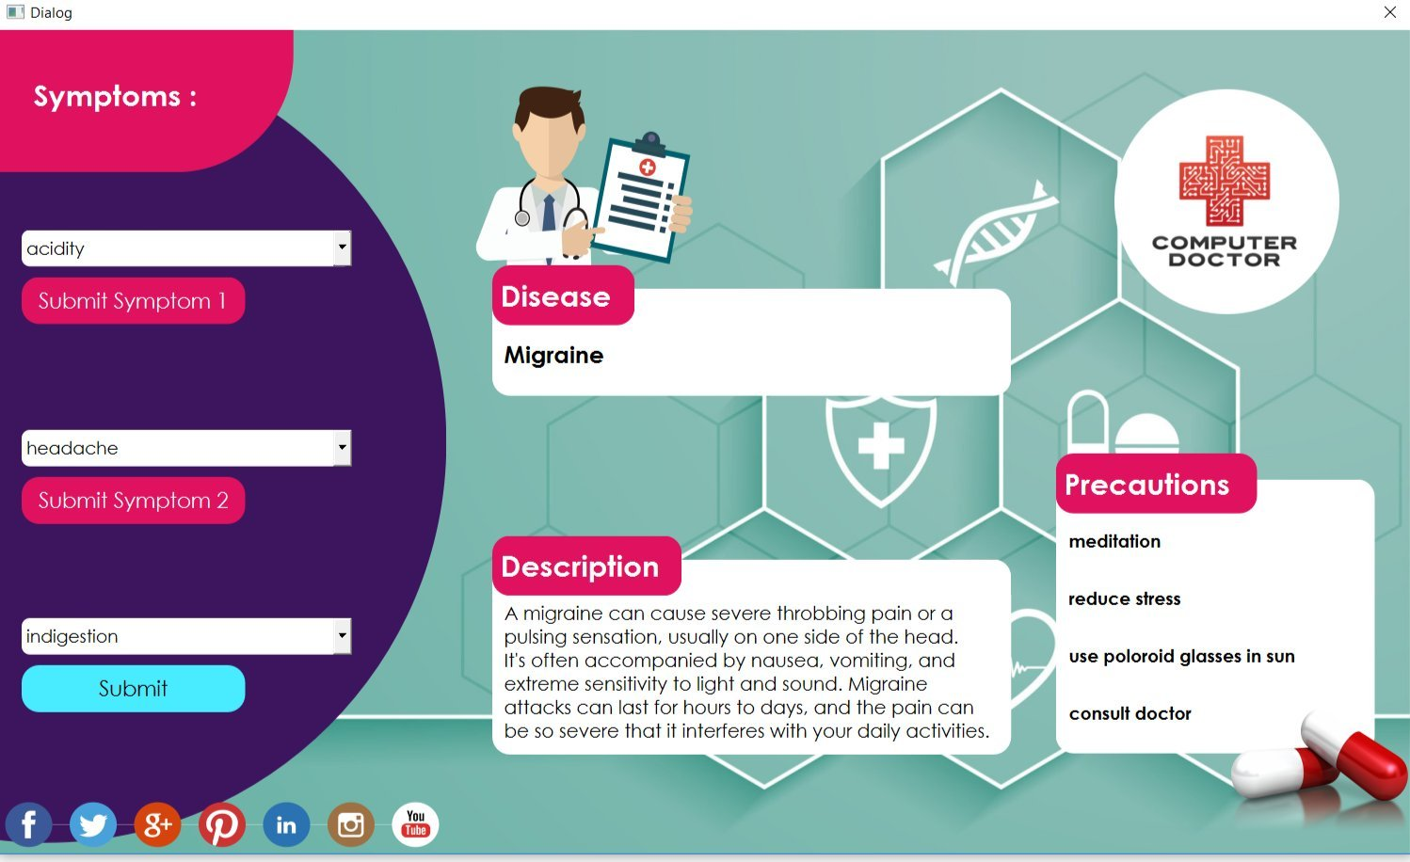

Slide 9

Conclusion
Stay Fit, Stay Healthy! with DD-MAS

Slide 10
Future work
Will create a separate "menu" window and database for entering and storing signup details, so that it could allow new sign-ups.
Will include more diseases to its database and make it more versatile, and include age and gender criteria to predict disease. Further improvement in GUI with time, and adding more functionalities to it.

Slide 11

References -
Qt Tutorials from -https://youtu.be/EkjaiDsiM-Q
Images from - https://www.cleanpng.com/
SQLite from- From web and books.

Slide 12
Thank You!

